Slide 1
Learning Objective
I will solve contextual polynomial problems.
Success Criteria
At the end of the lesson, I will be able to:
Solve contextual polynomial problems

Slide 2
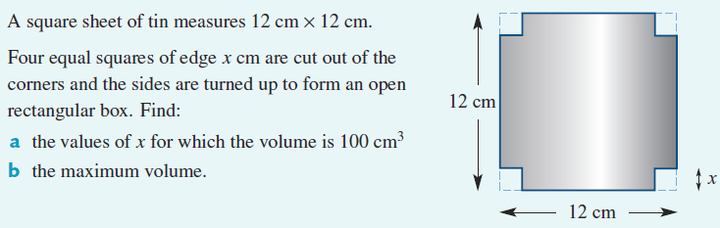
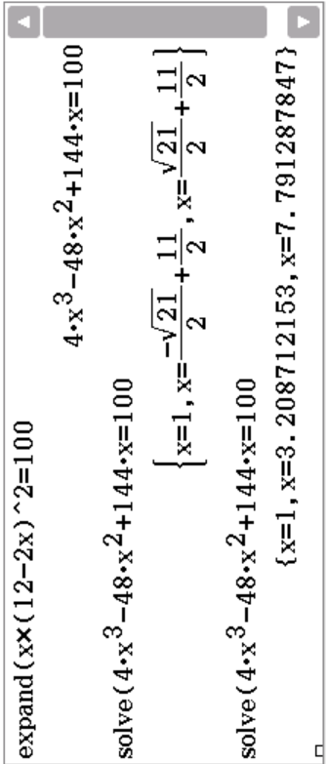

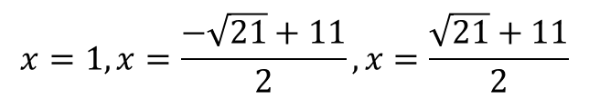



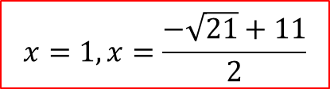






Cambridge Example 34
Area of base = ${\left(12−2x\right)}^{2}$
Volume of box = ${x\left(12−2x\right)}^{2}$
$$12−2x$$
What would be the domain for the volume?
$$\{x∈ℝ, 0<x<6\}$$
${x\left(12−2x\right)}^{2}=100$
$$4x^{3}−48x^{2}+144x−100=0$$
$$x=1, x=\frac{−\sqrt{21}+11}{2},x=\frac{\sqrt{21}+11}{2}$$
$$x<6$$
$$x=1, x=\frac{−\sqrt{21}+11}{2}$$

Slide 3
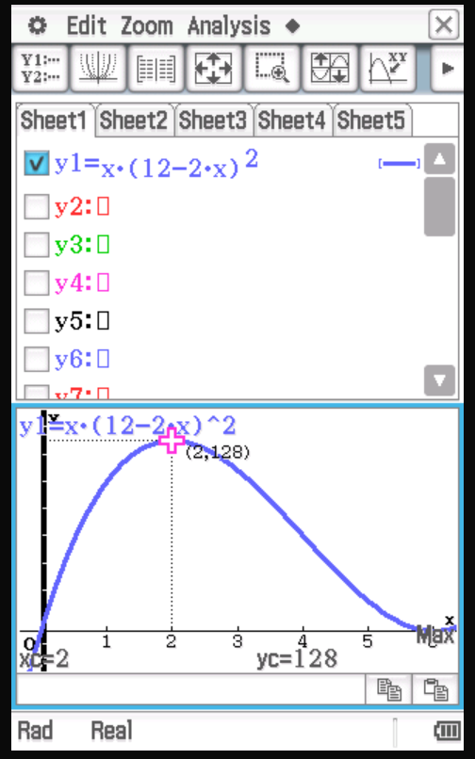
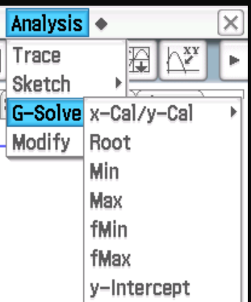

Cambridge Example 34

Slide 4
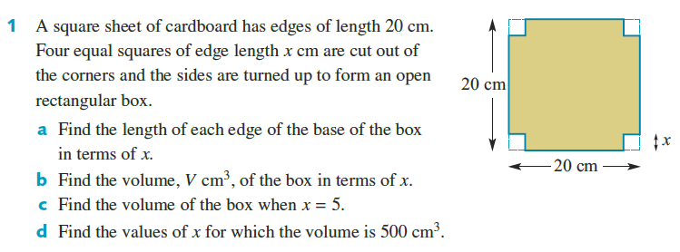
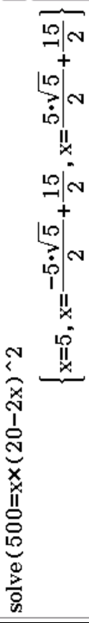

Cambridge Ex 7I Q1

Slide 5
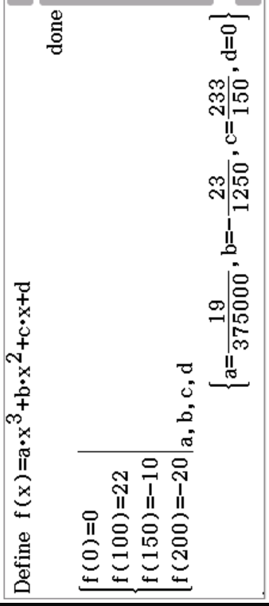
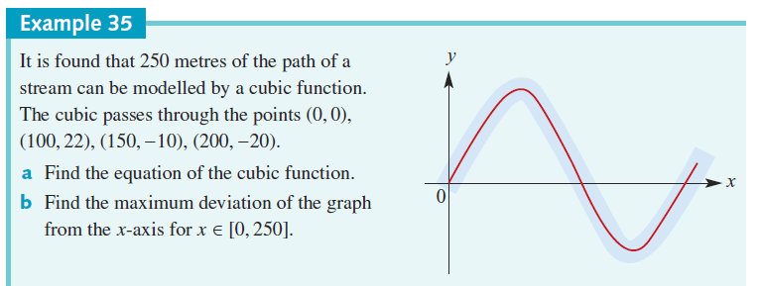
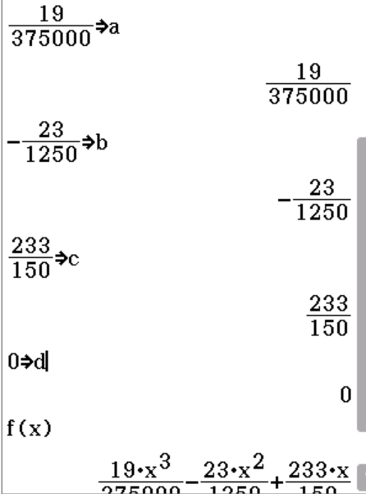
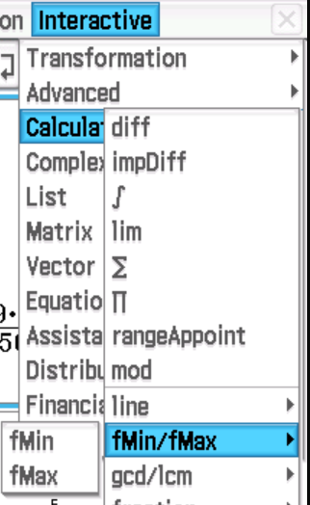
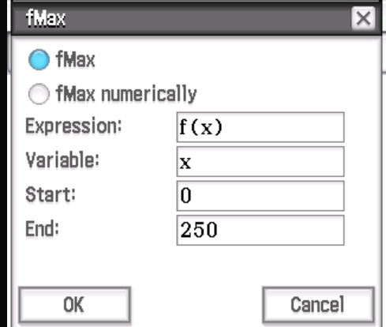
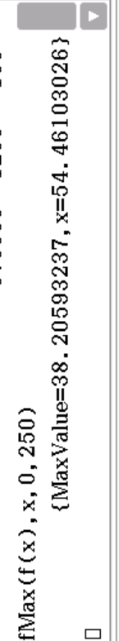



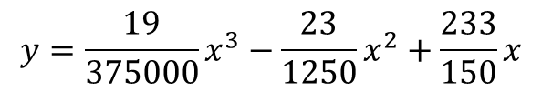
Cambridge Example 35
$$y=\frac{19}{375000}x^{3}−\frac{23}{1250}x^{2}+\frac{233}{150}x$$
Define your variables a,b,c
The max deviation $=38.21$ when $x=54.46$

Slide 6
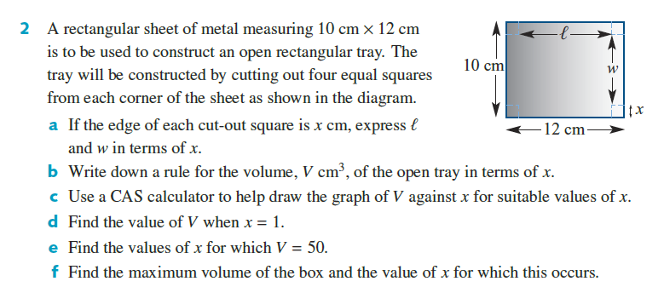
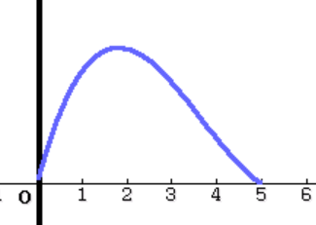
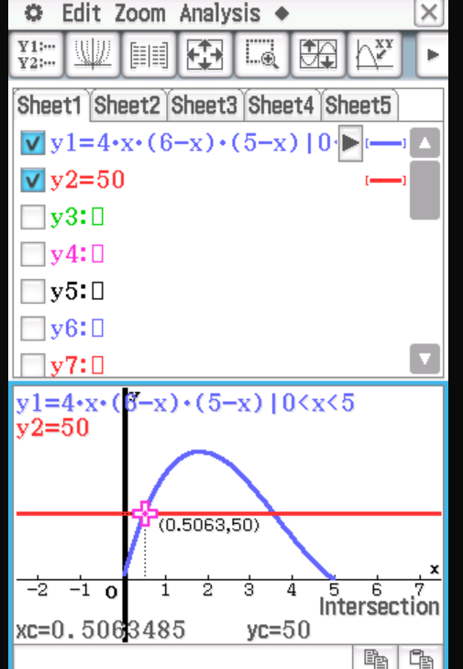
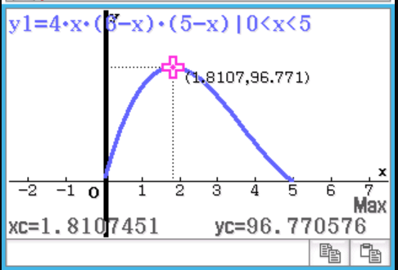
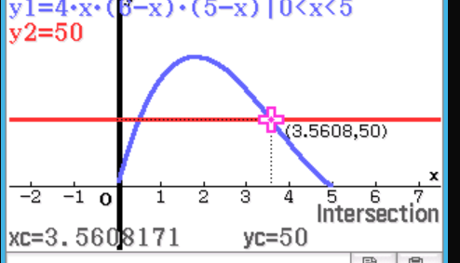
Cambridge Ex 7I Q2

Slide 7
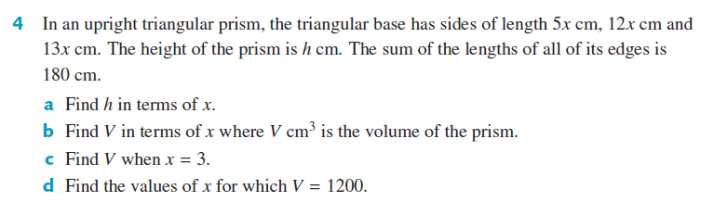












Cambridge Ex 7I Q4

Slide 8
Independent Practice
Complete Cambridge Ex 3L

